Slide 1
The Effectiveness of Randomness Test Suites for Fixed Length Functions
Luke Y. Tao
Massanutten Regional Governor’s School
Research
Ms. Klus
April 16, 2021

Slide 2
Outline
What is a Block Cipher?
Test Suites
popular test suites: NIST, Dieharder
problems: multiple outputs, mode-of-operation dependent
alternative approach: CryptoStat
Conclusions and Discussions

Slide 3
Block Ciphers

Slide 4
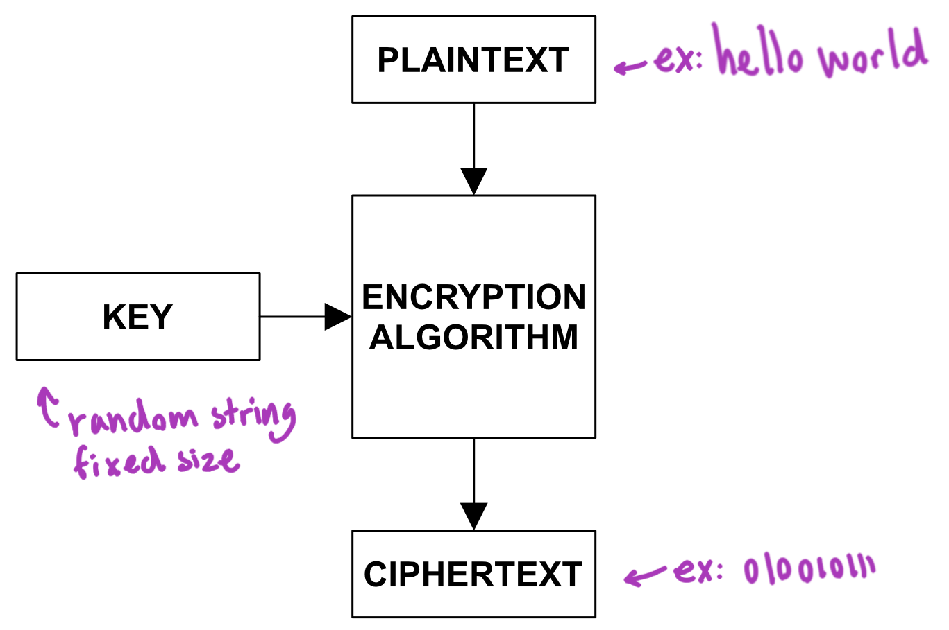
Encryption
Figure 1 Encryption Diagram
In the modern age, everything from banking to taking a class can be done online.
Encryption protects the privacy and personal information of users

Slide 5
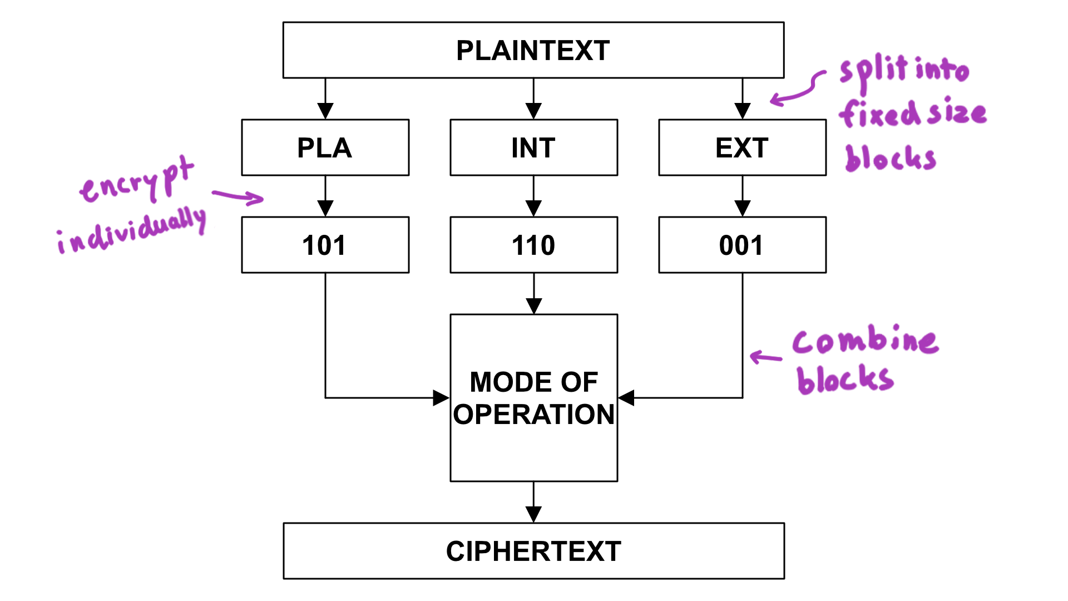
Block Cipher
Encrypts constant sized chunks which are combined using a mode of operation
Explain that more random = more secure

Slide 6
Test Suites

Slide 7
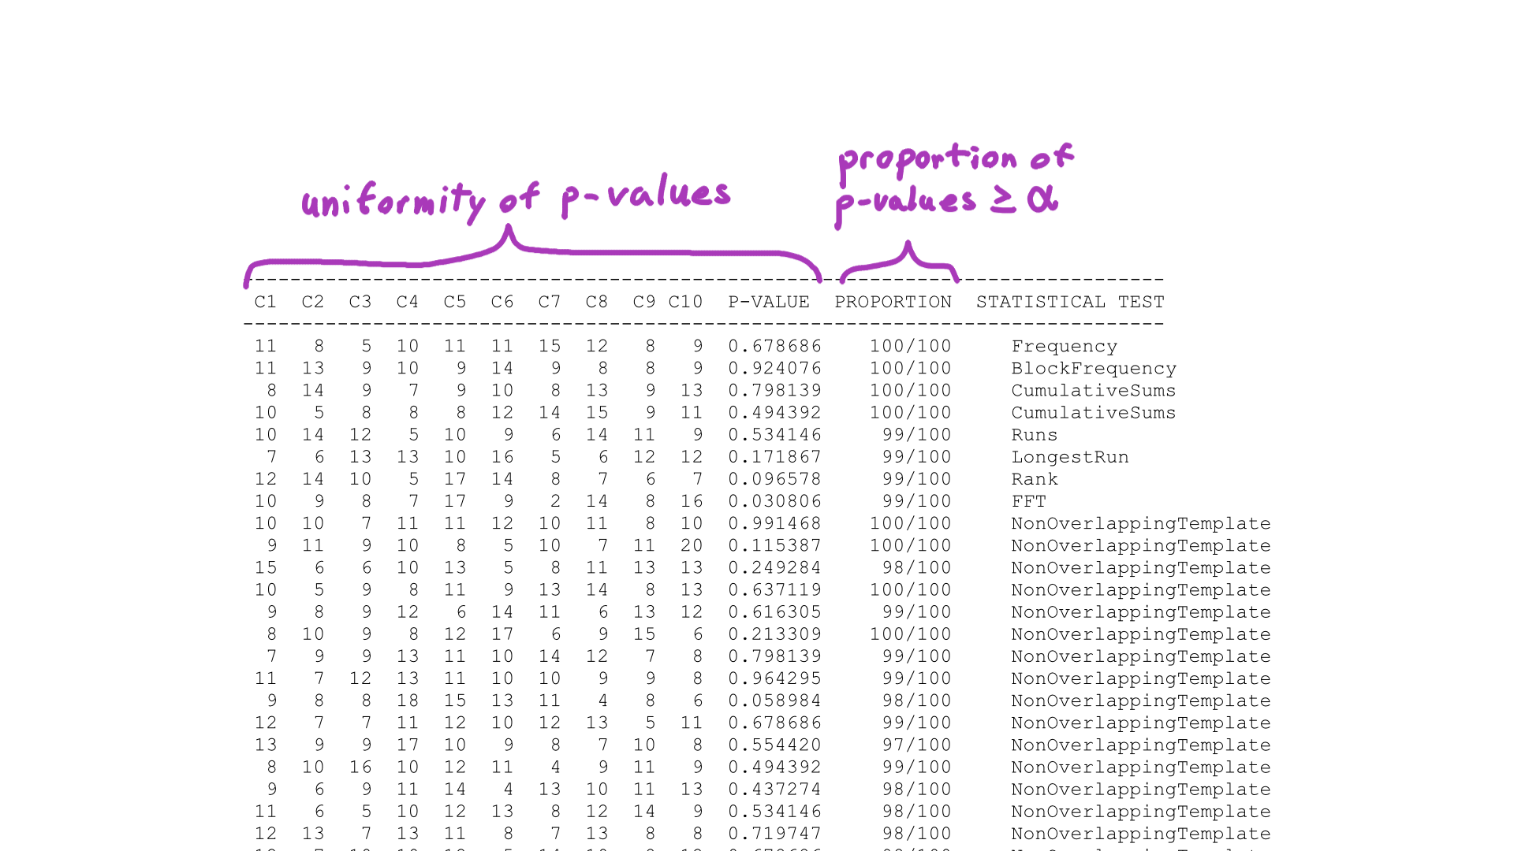
NIST Statistical Test Suite
Figure 3 Excerpt of NIST Test Results
user controlled number of samples and sample size
15 tests to detect deviation from randomness in the sequences
Frequency test
Runs test
2 layers of p-values (Rukhin, 2011)

Slide 8
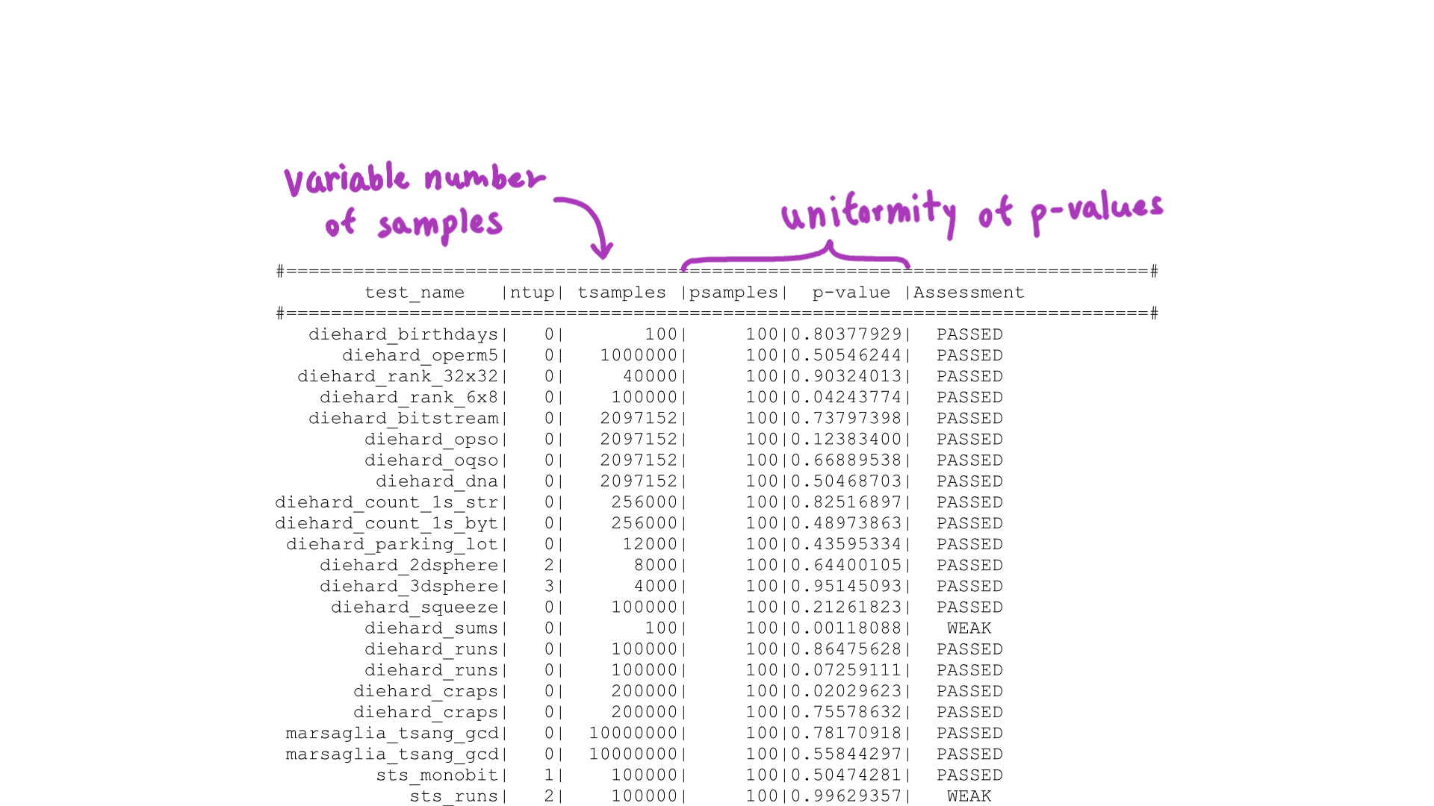
Dieharder
Figure 4 Excerpt of Dieharder Test Results
variable number of samples
2 layers of p-values
contains tests from - Diehard, NIST
intended for PRNGs
(Brown, 2021)

Slide 9
Problems

Slide 10
Multiple Scores
Outputs many statistics based on short subsequences instead of a single summary statistic from one long sequence (Rukhin, 2011)
Makes it difficult to compare results
Different tests have different levels of importance, reliability, and accuracy (Rukhin, 2010)
Difficult to interpret a multitude of p-values
2 ways to interpret p-values
Is the proportion of p-values >= a acceptable?
Are the p-values ~ uniform(0, 1)?

Slide 11
Mode-of-Operation Dependent

Slide 12
Definitions
Exclusive-or (XOR)
Logical operation
True if and only if parameters are different
Easily reversible
Used to combine different components in modes of operation
1100
⊕ 1010
0110
Initialization Vector
unique/random value
fixed length
used as the first value in a mode of operation

Slide 13
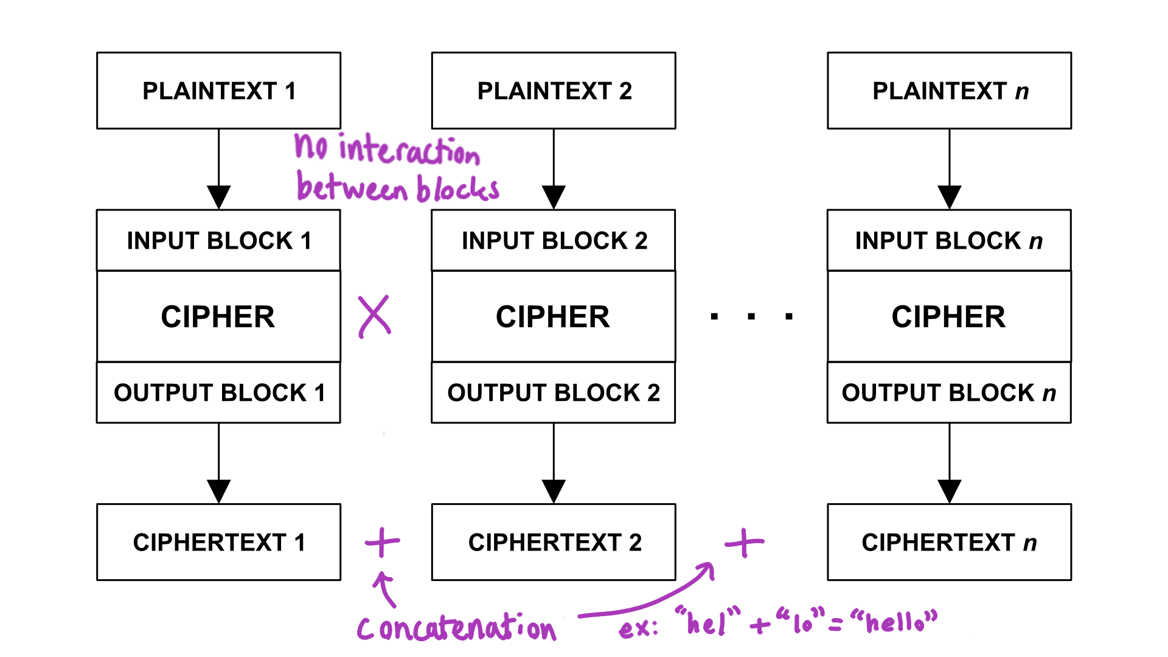
Figure 7 Electronic Codebook (ECB)

Slide 14
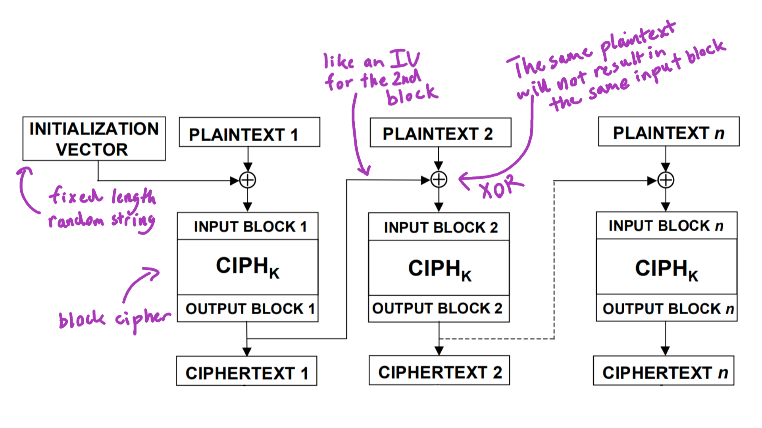
Figure 10 Cipher Block Chaining (CBC)
Dworkin, M. (2001). Recommendation for Block Cipher Modes of Operation: Methods and Techniques. United States Department of Commerce, National Institute of Standards and Technology. https://nvlpubs.nist.gov/nistpubs/Legacy/SP/nistspecialpublication800-38a.pdf

Slide 15
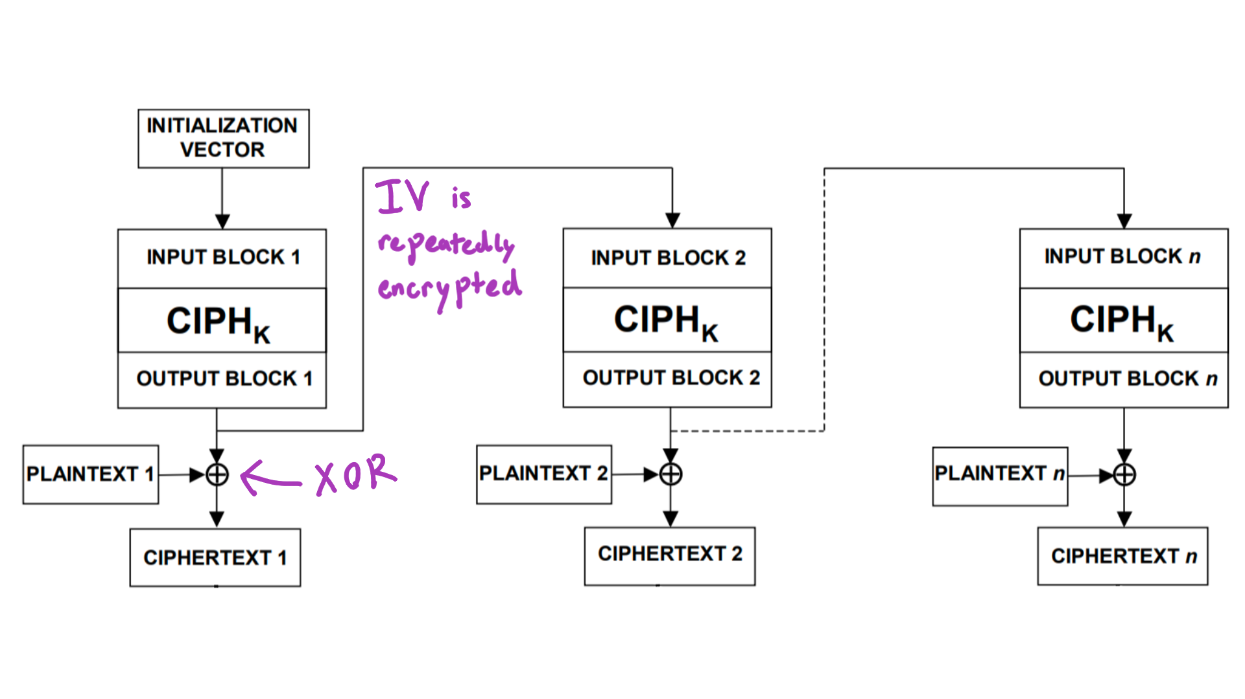
Figure 11 Output Feedback (OFB)
Dworkin, M. (2001). Recommendation for Block Cipher Modes of Operation: Methods and Techniques. United States Department of Commerce, National Institute of Standards and Technology. https://nvlpubs.nist.gov/nistpubs/Legacy/SP/nistspecialpublication800-38a.pdf

Slide 16
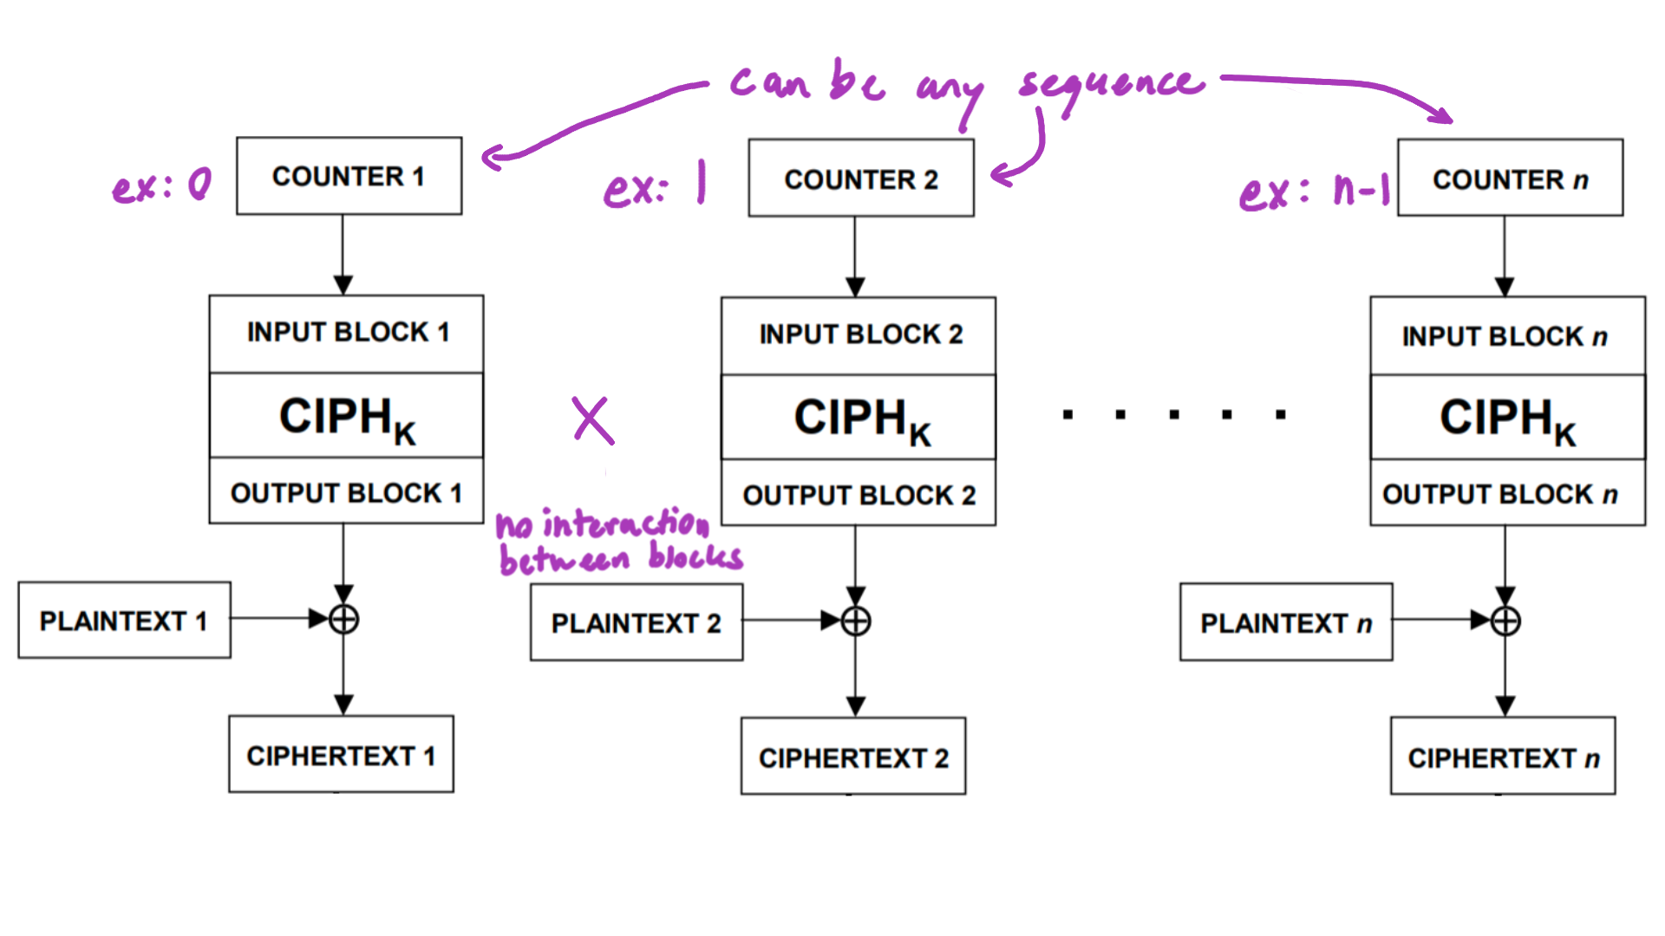
Figure 12 Counter (CTR)
Dworkin, M. (2001). Recommendation for Block Cipher Modes of Operation: Methods and Techniques. United States Department of Commerce, National Institute of Standards and Technology. https://nvlpubs.nist.gov/nistpubs/Legacy/SP/nistspecialpublication800-38a.pdf

Slide 17
Table 1 NIST Statistical Suite Results for Different Modes of Operation
Encryption Algorithm | Mode of Operation | Passed | Failed
AES | ECB | 1 | 187
 | CBC | 187 | 1
 | OFB | 187 | 1
 | CTR | 185 | 3

Slide 18
Table 2 DieHarder Results for Different Modes of Operation
Encryption Algorithm | Mode of Operation | Passed | Weak | Failed
AES | ECB | 0 | 0 | 114
 | CBC | 111 | 3 | 0
 | OFB | 110 | 4 | 0
 | CTR | 114 | 0 | 0

Slide 19
Why This Matters
NIST and Dieharder must convert the block cipher into a PRNG using one of these modes of operation. This introduces bias and uncertainty about the randomness produced by the cipher.

Slide 20
Alternative Approach

Slide 21
CryptoStat
Bayesian thinking
Directly tests the input-to-output mapping of a block cipher, does not use modes of operation
Easily combines multiple test results (Kaminsky, 2019)
Figure 4 Example CryptoStat Test Results

Slide 22
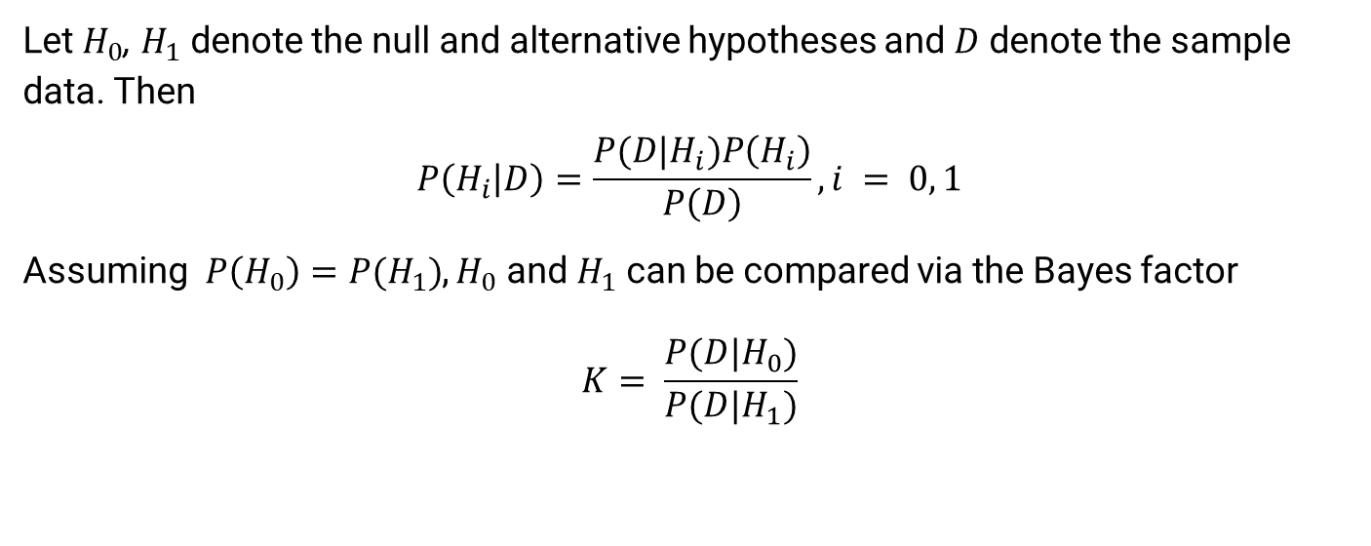
Bayesian Hypothesis Test
Let $H_{0}$, $H_{1}$ denote the null and alternative hypotheses and $D$ denote the sample data. Then
$$P\left(H_{i} | D\right)=\frac{P(D|H_{i})P\left(H_{i}\right)}{P\left(D\right)}, i = 0, 1$$
Assuming$P\left(H_{0}\right)=P(H_{1})$, $H_{0}$ and $H_{1}$ can be compared via the Bayes factor
$$K= \frac{P(D|H_{0})}{P(D|H_{1})}$$

Slide 23
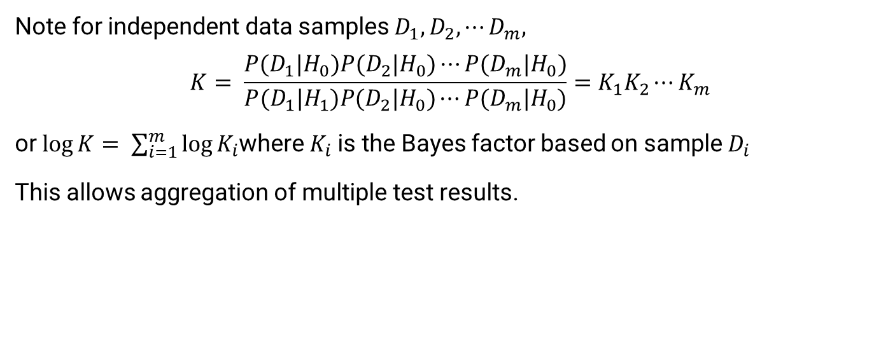
Bayesian Hypothesis Test Pt. 2
Note for independent data samples $D_{1}, D_{2},⋯D_{m},$
$$K= \frac{P(D_{1}|H_{0})P(D_{2}|H_{0})⋯P(D_{m}|H_{0})}{P(D_{1}|H_{1})P(D_{2}|H_{0})⋯P(D_{m}|H_{0})}=K_{1}K_{2}⋯K_{m}$$
or $\log{K}= \sum_{i=1}^{m}{\log{K_{i}}}$where $K_{i}$ is the Bayes factor based on sample $D_{i}$
This allows aggregation of multiple test results.

Slide 24
Results

Slide 25
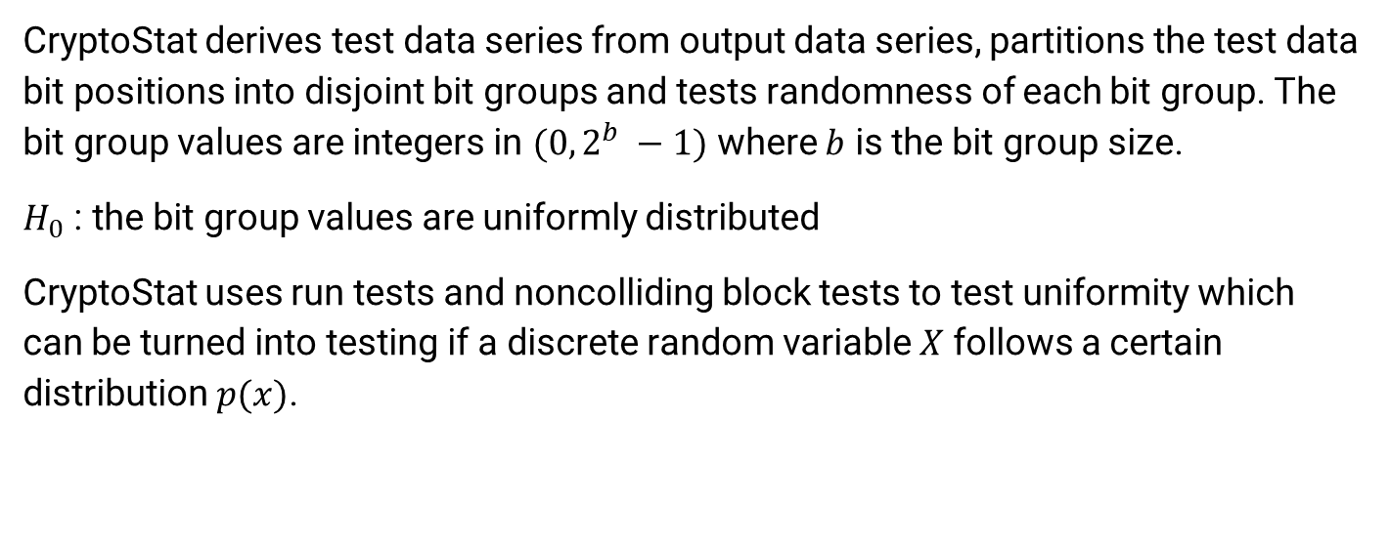
CryptoStat
CryptoStat derives test data series from output data series, partitions the test data bit positions into disjoint bit groups and tests randomness of each bit group. The bit group values are integers in $(0, 2^{b} −1)$ where $b$ is the bit group size.
$H_{0}$ : the bit group values are uniformly distributed
CryptoStat uses run tests and noncolliding block tests to test uniformity which can be turned into testing if a discrete random variable $X$ follows a certain distribution $p(x)$.

Slide 26
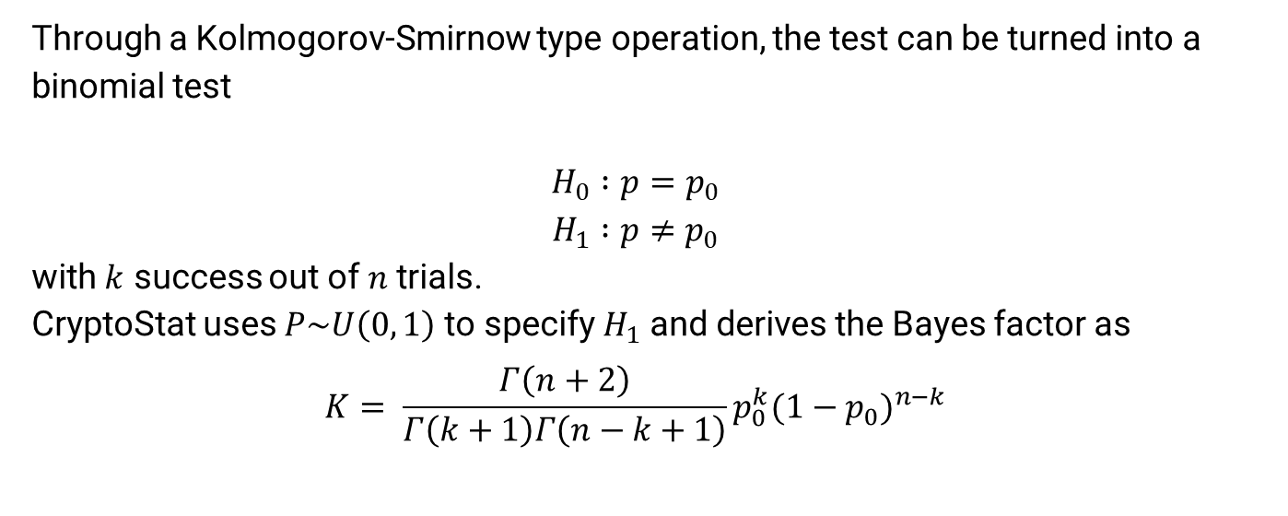
Bayes Test
Through a Kolmogorov-Smirnow type operation, the test can be turned into a binomial test
$$H_{0} :p=p_{0}$$
$$H_{1} :p≠p_{0}$$
with $k$ success out of $n$ trials.
CryptoStat uses $P\sim U\left(0, 1\right)$ to specify $H_{1}$ and derives the Bayes factor as
$$K= \frac{Γ\left(n+2\right)}{Γ\left(k+1\right)Γ\left(n−k+1\right)}p_{0}^{k}{(1−p_{0})}^{n−k}$$

Slide 27
Sample Size
find min size that tests as random

Slide 28
Different Distributions / Priors
find factorial of 1 million

Slide 29
Discussion

Slide 30
References

Slide 31
Ahmad, T., & Younis, U. (2014). Randomness testing of non-cryptographic hash functions for real-time hash table based storage and look-up of URLs. Journal of Network and Computer Applications. 41, 197-205. doi.org/10.1016/j.jnca.2013.11.007
Brown, R. G. (2021). Dieharder: A Random Number Test Suite. Duke University Physics Department. webhome.phy.duke.edu/~rgb/General/dieharder.php
Dworkin, M. (2001). Recommendation for Block Cipher Modes of Operation: Methods and Techniques. United States Department of Commerce, National Institute of Standards and Technology. nvlpubs.nist.gov/nistpubs/Legacy/SP/nistspecialpublication800-38a.pdf
Gevorkyan, M.N., Demidova, A.V., Korol’kova, A.V. & Kulyabov, D.V. (2020). A Practical Approach to Testing Random Number Generators in Computer Algebra Systems. Comput. Math. and Math. Phys. 60, 65–73. doi.org/10.1134/S096554252001008X

Slide 32
Kaminsky, A. (2019a). CryptoStat: Bayesian Statistical Analysis of Cryptographic Functions. Rochester Institute of Technology. cs.rit.edu/~ark/parallelcrypto/cryptostat/
Kaminsky, A. (2019b). Parallel Java 2 Library. Rochester Institute of Technology. cs.rit.edu/~ark/pj2.shtml
Kaminsky, A. (2019c). Testing the randomness of cryptographic function mappings. Cryptology ePrint Archive. eprint.iacr.org/2019/078.pdf
National Institute of Standards and Technology. (2016a). AES Development - Cryptographic Standards and Guidelines. United States Department of Commerce. csrc.nist.gov/projects/cryptographic-standards-and-guidelines/archived-crypto-projects/aes-development
National Institute of Standards and Technology. (2016b). NIST SP 800-22: Download Documentation and Software. United States Department of Commerce. csrc.nist.gov/projects/random-bit-generation/documentation-and-software

Slide 33
Patil, P., Narayankar, P., Narayan, D.G., & Meena S.M. (2016). A Comprehensive Evaluation of Cryptographic Algorithms: DES, 3DES, AES, RSA and Blowfish. Procedia Computer Science, 78, 617-624. doi.org/10.1016/j.procs.2016.02.108
Rukhin, A. (2011). Statistical Testing of Randomness: New and Old Procedures appeared as Chapter 3 in Randomness through Computation, H. Zenil ed. World Scientific, 2011, 33-51. doi.org/10.1142/9789814327756_0003
Rukhin, A., Soto, J., Nechvatal, J., Smid, M., Barker, E., Leigh, S., Levenson, M., Vangel, M., Banks, D., Heckert, A., Dray, J., & Vo, S. (2010). A Statistical Test Suite for Random and Pseudorandom Number Generators for Cryptographic Applications. United States Department of Commerce, National Institute of Standards and Technology. tsapps.nist.gov/publication/get_pdf.cfm?pub_id=906762
Soto, J. (1999). Randomness Testing of the Advanced Encryption Standard Candidate Algorithms (NISTIR 6390). United States Department of Commerce, National Institute of Standards and Technology. tsapps.nist.gov/publication/get_pdf.cfm?pub_id=151193

